Slide 1
Summer 2017 Deaf Youth Leadership Camp
In Yaoundé, Cameroon

Slide 2
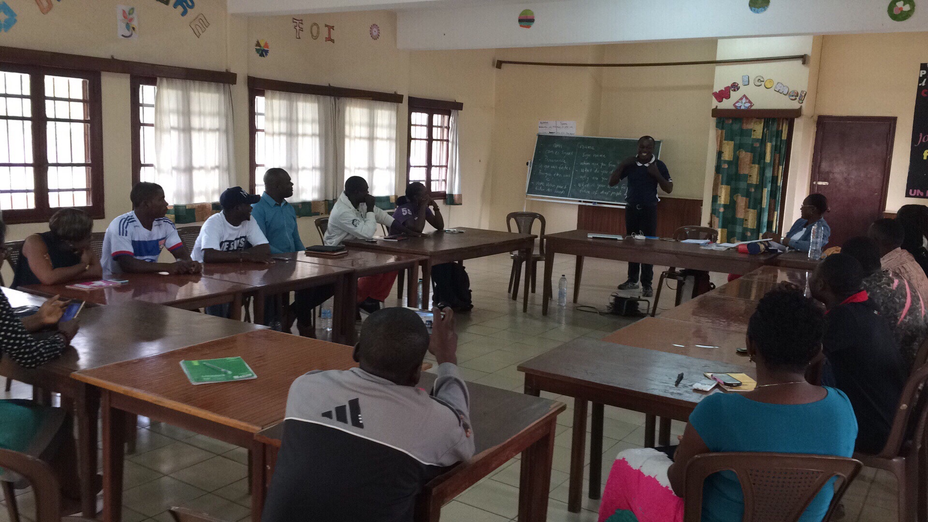

Slide 3
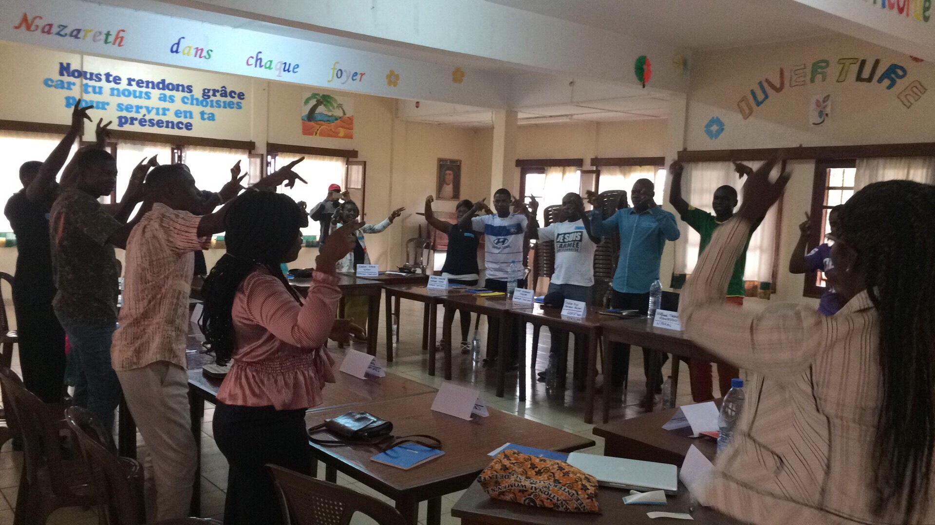

Slide 4
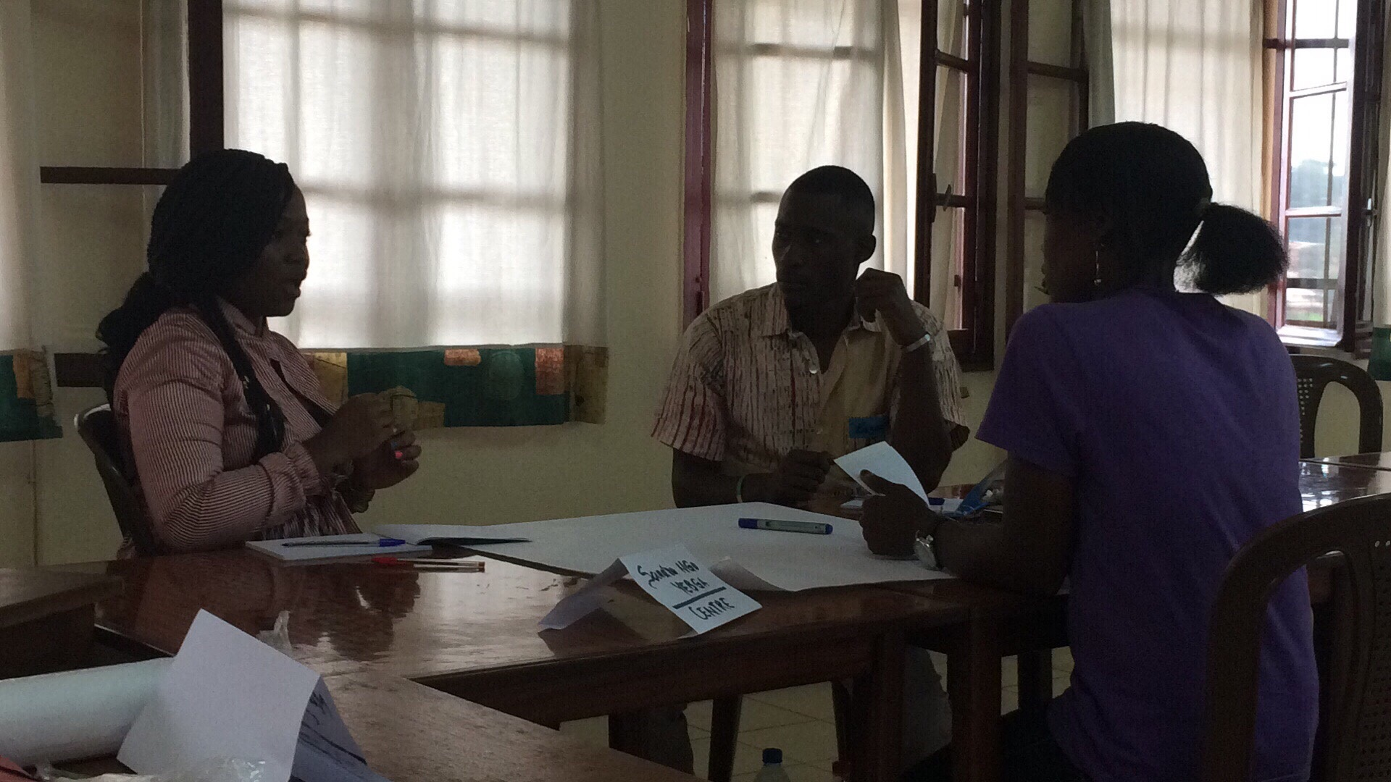

Slide 5
Behind the Successful Case of Jane Ihuoma Ottah vs. Rivers State University in Nigeria
It was the effective action and leadership of STANDU, Inc. that brought the lawyers for Jane
See:
http://allafrica.com/stories/201602091138.html
https://www.pmnewsnigeria.com/2016/02/19/expelled-female-student-sues-university/
https://www.premiumtimesng.com/news/headlines/207272-rivers-university-student-expelled-speech-hearing-challenges-returns-school.html

Slide 6
Justice for Jane

